Slide 1


郑凯文
2018 - 9 - 14
Answering Location-Aware Graph Reachability
Queries on GeoSocial Data
Notes:
Mohamed Sarwat是计算机科学助理教授和 数据系统（DataSys）实验室主任 在亚利桑那州立大学。在加入ASU之前，Mohamed分别于2011年和2014年获得了明尼苏达大学的计算机科学硕士和博士学位。他的研究兴趣在于广泛的数据管理系统。穆罕默德是明尼苏达大学博士论文奖学金的获得者。他的研究工作在第16届IEEE移动数据管理国际会议（MDM 2015）和第12届国际空间与时间数据库研讨会（SSTD 2011）以及最佳会议引文中获得了两项最佳研究论文奖。 IEEE第28届国际数据工程大会（ICDE 2012）。他还在第15届国际空间与时间数据库研讨会（SSTD 2017）上获得了计算社区联盟（CCC）蓝天创意奖，以获得最佳视觉论文（第3名）。Mohamed是GeoInformatica期刊的副主编，并担任主要数据管理和空间计算场所的审稿人/项目委员会成员。

Slide 2
OUTLINE
1
Introduction
2
Exist Approach
3
Our Approach
4
Initialization & Maintenance
5
Conclusion & Future Work
2/23

Slide 3
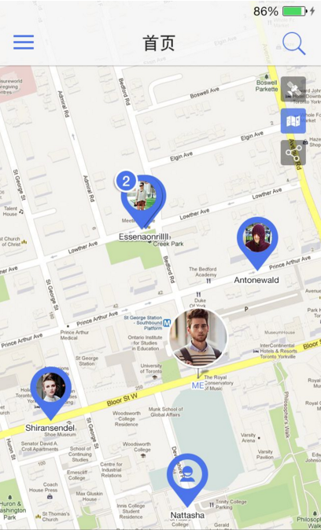

Introduction
The GeoSocial Graph
3/23

Slide 4

Introduction
P₄
P₁
P₃
Hi Siri , to find restaurants in
NewYork such that these restaurants are already visited by Mr.Du.
P₂
my friends
S₃
New York
S₁
S₄
R
S₂
RangeReach( P₁ , R )
Spatial vertex
two types of vertex: Person(P) , Restaurant(S)
An edge between two P vertices represents a friendship
An edge between a P and a S means that the Person visited the Restaurant
4/23

Slide 5
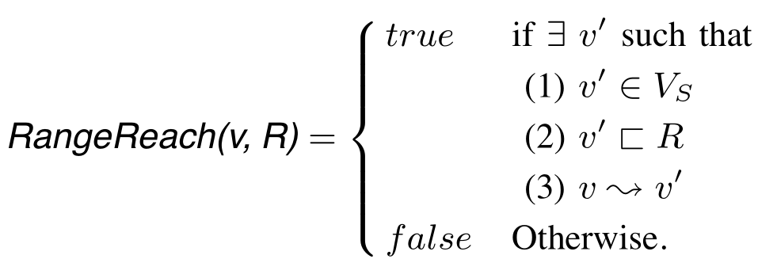
Preliminaries
P₄
P₁
P₃
P₂
S₃
S₁
S₄
R
S₂
GeoSocial Graph: directed property graph
where exists . may be a geometrical point, rectangle, or a polygon.
5/23

Slide 6
OUTLINE
1
Introduction
2
Exist Approach
3
Our Approach
4
Initialization & Maintenance
5
Conclusion & Future Work

Slide 7
Exist Approach
Approach I：Graph Traversal
P₄
P₁
P₃
P₂
using a classical graph traversal
DFS or BFS
S₃
S₁
Analysis： No storage or maintenance
and no pre-computed data structure.
Problem ： High query response time
S₄
R
S₂
RangeReach( P₁ , R )
Input:
Graph Vertex : P₁
Spatial Range : R
6/23

Slide 8
Exist Approach
Approach II： Transitive Closure (TC)
P₄
P₁
P₃
P₂
precomputes the transitive closure of the graph and stores it
S₃
S₁
S₄
R
S₂
P₁:{P₂,P₃,S₃,S₂,S₁}
P₂:{P₃,S₃,S₂,S₁}
P₃:{S₃}
Input:
Graph Vertex : P₁
Spatial Range : R
P₄:{S₄,P₁,P₂,P₃,S₃,S₂,S₁}
7/23
Notes:
当调用RangeReach（v，R）时，系统将通过传递闭包获取从v中可访问的所有空间顶点。如果至少有一个从v中可以到达的空间顶点也位于空间范围r中，那么系统就会返回true。

Slide 9
Exist Approach
Approach II： Transitive Closure (TC)
P₄
P₁
P₃
P₂
Analysis：Achieves the lowest query response time.
Problem ：pre-compute (and maintain) the graph transitive closure. storage overhead too large.
S₃
S₁
S₄
R
S₂
RangeReach( P₁ , R )
Input:
Graph Vertex : P₁
Spatial Range : R
7/23
Notes:
当调用RangeReach（v，R）时，系统将通过传递闭包获取从v中可访问的所有空间顶点。如果至少有一个从v中可以到达的空间顶点也位于空间范围r中，那么系统就会返回true。

Slide 10
Exist Approach
Approach III： Spatial-Reachability Indexing (abbr. SpaReach)
P₄
P₁
P₃
P₂
Uses a spatial index [1] , [2] to locate all spatial vertices V_{R} that lie within the spatial range R.
And then uses a reachability index [3], [4] to find out whether v can reach any vertex in V_{R}.
S₃
S₁
S₄
R
S₂
[1] The R*-Tree:An Efficient and Robust Access Method for Points and Rectangles.
RangeReach( P₁ , R )
Input:
Graph Vertex : P₁
Spatial Range : R
[2] The Design and Analysis of Spatial Data Structures
[3] FELINE
[4] PLL
8/23

Slide 11
Exist Approach
The state-of-the-art approach:
Spatial-Reachability Indexing (abbr. SpaReach)
P₄
P₁
P₃
P₂
Problem
S₃
S₁
(1)Needs to probe the reachability index for spatial vertices that may never be reached from v.
S₄
R
S₂
(2)Has to store and maintain two index structures which may preclude scalability.
RangeReach( P₁ , R )
Input:
Graph Vertex : P₁
Spatial Range : R
9/23

Slide 12
OUTLINE
1
Introduction
2
Exist Approach
3
Our Approach
4
Initialization & Maintenance
5
Conclusion & Future Work

Slide 13
Our Approach
GEO REACH
Balance
between
query processing efficiency
and
scalability (in terms of storage overhead)
10/23

Slide 14
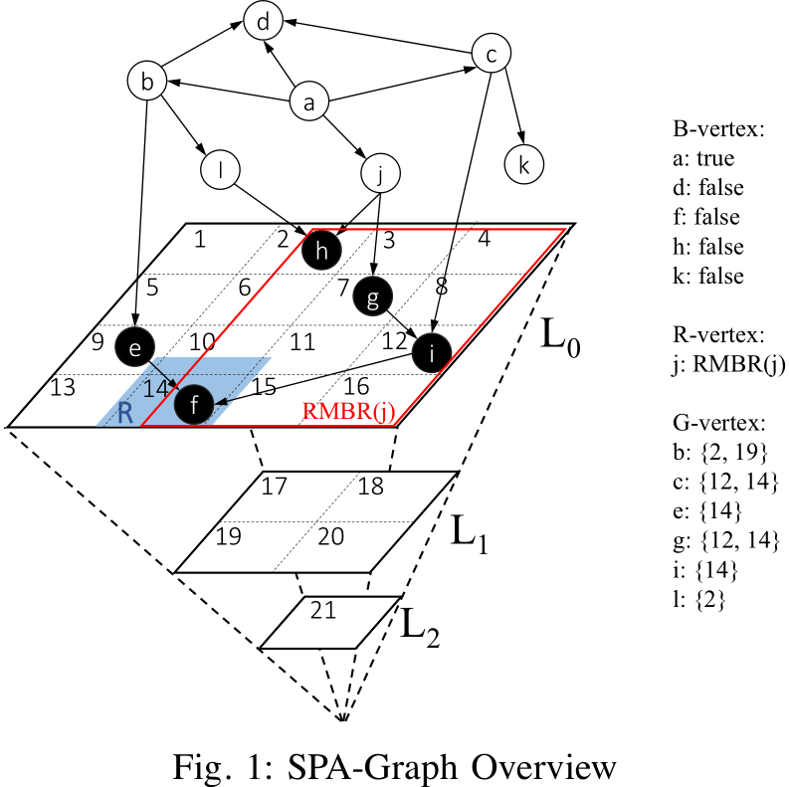
Our Approach
GEO REACH
SPatially-Augmented Graph(SPA-Graph)
Spatial Vertex is balck;
Divide Grid Cell;
Augmented Spatial Index;
11/23

Slide 15
Our Approach
GEO REACH
Data Structure:
B-Vertex: stores whether v can reach any Vs
R-Vertex: stores a Reachability Minimum Bounding Rectangle
(RMBR) top-left lower-right
G-Vertex: stores a list of spatial grid cells
11/23

Slide 16
Our Approach
GEO REACH
Query Processing:
RangeReach( v , R )
RangeReach( d , R )
FALSE
TRUE
RangeReach( a , R )
Case I (B-vertex): False then stop, else further traversal
Case II (R-vertex):Three cases
a.RMBR(v) lies within R
b.All reachable spatial vertices of v is outside R
c.RMBR(v) is partially covered by R
Case III (G-vertex):
It's same like Case II
12/23

Slide 17
OUTLINE
1
Introduction
2
Exist Approach
3
Our Approach
4
Initialization & Maintenance
5
Conclusion & Future Work

Slide 18
Initialization & Maintenance
MAX_RMBR: If area of RMBR(v) is larger than it .
v: R-vertex to B-vertex.
(0.8A)
MAX_REACH_GRIDS:
If the number of grid cells in ReachGrid(v) exceed it.
v: G-vertex to R-vertex.
(MAX_REACH_GRIDS = 3)
13/23

Slide 19
Initialization & Maintenance
(1) follows the topological order
accumulate reachability information
(2) follows the rule of parameter
initial type of v by checking
exact types of out-neighbors of v
14/23

Slide 20
Initialization & Maintenance
Example:
MAX_RMBR = 0.8A
MAX_REACH_GRIDS = 3
one correct topological is
ReachGrid(v) is updated by adding in ReachGrid(v') and Grid(v')
v' ∈ v_{out}
ReachGrid(i) =ReachGrid(f ) ∪ Grid(f) = ∅∪ {14} = {14}
ReachGrid(g) =ReachGrid(i) ∪ Grid(i) = {14}∪ {12} = {12,14}
15/23

Slide 21
Initialization & Maintenance
Example:
MAX_RMBR = 0.8A
MAX_REACH_GRIDS = 3
one correct topological is
ReachGrid(b) =ReachGrid(l) ∪ReachGrid(e) ∪Grid(e) = {2}∪{14}∪{9} = {2,9,14}
ReachGrid(j) = {2,7,12,14}
MAX_REACH_GRIDS = 3
v: G-vertex to R-vertex.
MAX_RMBR = 0.8A
j:RMBR(j)
16/23

Slide 22
Initialization & Maintenance
Example:
MAX_RMBR = 0.8A
MAX_REACH_GRIDS = 3
one correct topological is
ReachGrid(a) = {2,7,9,12,14}
MAX_REACH_GRIDS = 3
a: G-vertex to R-vertex.
MAX_RMBR = 0.8A
a:RMBR(a) > 0.8A
a: R-vertex to B-vertex.
a:true
17/23

Slide 23
OUTLINE
1
Introduction
2
Exist Approach
3
Our Approach
4
Initialization & Maintenance
5
Conclusion & Future Work

Slide 24
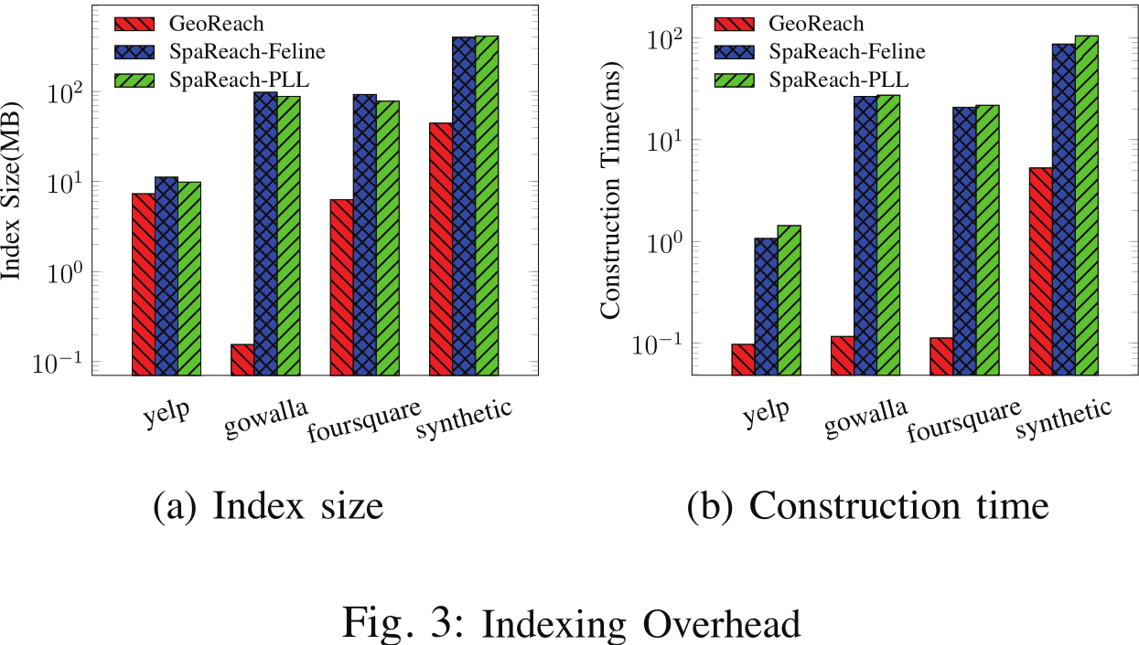
Conclusion & Future Work
19/23

Slide 25
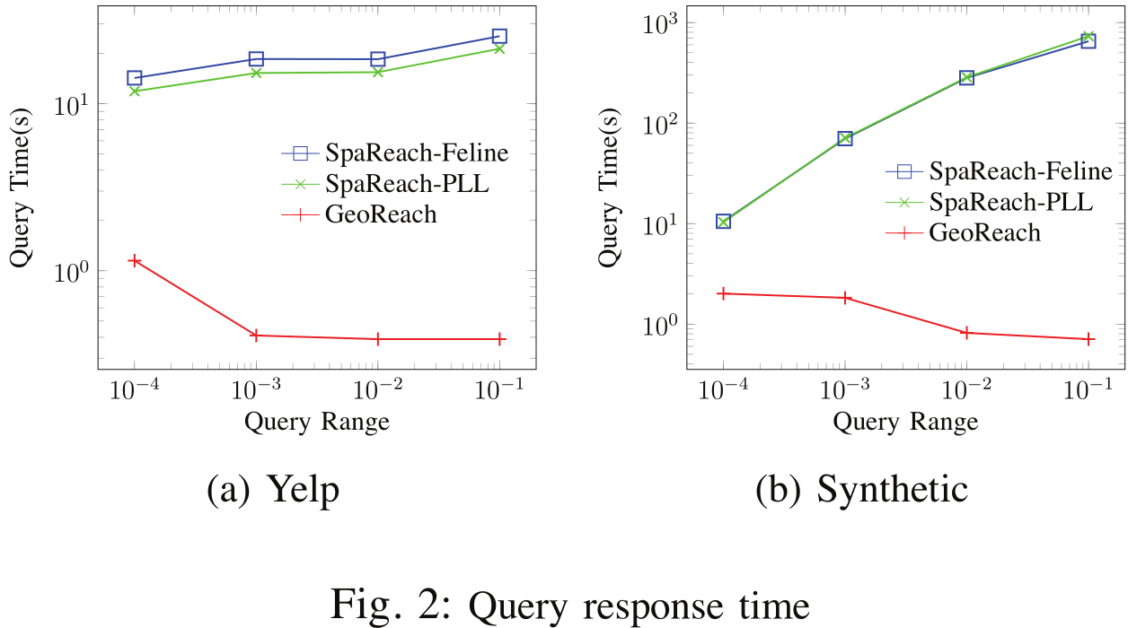
Conclusion & Future Work
Input query rectangle varies from 0.0001 to 0.1
Run 500 random queries
20/23

Slide 26
Conclusion & Future Work
The paper motivates location-aware reachability queries RangeReach( v , R ) over a GeoSocial graph.
A novel approach GEO REACH is proposed to efficiently answers the query.
21/23

Slide 27
Conclusion & Future Work
In the future, we plan to study the extensibility of
GEO REACH to support different spatial predicates (e.g., spatial join).
Spatial Influence Maximization,
Location and Social-Aware Recommendation,
Location-Aware Citation Network Analysis.
22/23

Slide 28
Thank You!

